Slide 1
XPath and XQuery

Slide 2
Lecture Outline
XPath: a practical language to select nodes from an XML document
XQuery: compatible with XPath and is used for finding and extracting elements and attributes from XML documents.
Exercise

Slide 3
Querying XML
In relational databases, parts of a database can be selected and retrieved using SQL
Same necessary for XML documents
Essentially moving from relations to trees
Query languages: XQuery, XQL, XML-QL
The central concept of XML query languages is a path expression
Specifies how a node or a set of nodes, in the tree representation of the XML document can be reached

Slide 4
XPath
XPath is a language for addressing parts of an XML document.
It operates on the tree data model of XML
It has a non-XML syntax
Two types of Path Expressions
Absolute (starting at the root of the tree)
Syntactically they begin with the symbol /
It refers to the root of the document (situated one level above the root element of the document)
Relative to a context node

Slide 5
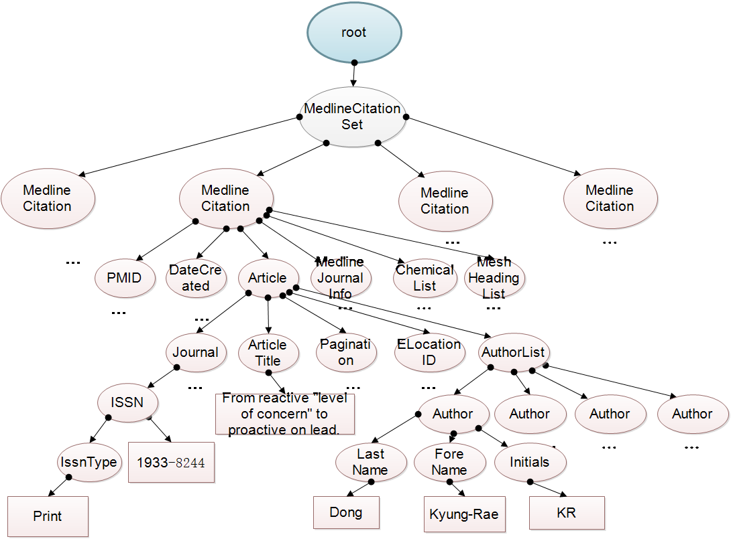
Path through Tree Model
Finding all the papers with a journal ISSN “1933-8244”

Slide 6
PubMed Example--medsampTest10.xml
<MedlineCitation Owner="NLM" Status="MEDLINE">
<PMID Version="1">23930790</PMID>
<DateCreated>
<Year>2013</Year>
<Month>08</Month>
<Day>12</Day>
</DateCreated>
<Article PubModel="Print">
<Journal>
<ISSN IssnType="Print">1933-8244</ISSN>
<JournalIssue CitedMedium="Internet">
<Volume>69</Volume>
<Issue>1</Issue>
<PubDate>
<Year>2014</Year>
</PubDate>
</JournalIssue>
<Title>Archives of environmental &amp; occupational health</Title>
<ISOAbbreviation>Arch Environ Occup Health</ISOAbbreviation>
</Journal>
<ArticleTitle>From reactive "level of concern" to proactive on lead.</ArticleTitle>
...

Slide 7
General Form of Path Expressions
A path expression consists of a series of steps, separated by slashes
/MedlineCitationSet/MedlineCitation/DateCreated/Year
A step consists of
An axis specifier,
A node test, and
An optional predicate
//DateCreated[1]/Year[1]
predicates
node test
axis specifier

Slide 8
General Form of Path Expressions (2)
An axis specifier determines the tree relationship between the nodes to be addressed and the context node
E.g. parent, ancestor, child (the default), sibling, attribute node
// is such an axis specifier: descendant or self
//child::PMID/attribute::Version
//PMID/@Version

Slide 9
General Form of Path Expressions (3)
A node test specifies which nodes to address
The most common node tests are element names
E.g., * addresses all element nodes
comment() addresses all comment nodes
//Author/*

Slide 10
General Form of Path Expressions (4)
Predicates (or filter expressions) are optional and are used to refine the set of addressed nodes
E.g., the expression [1] selects the first node
[position()=last()] selects the last node
[position() mod 2 =0] selects the even nodes

Slide 11
Path Expressions in XPath (1)
Address all PMID elements
/MedlineCitationSet/MedlineCitation/PMID
Addresses all PMID elements that are children of the MedlineCitation element node.

Slide 12
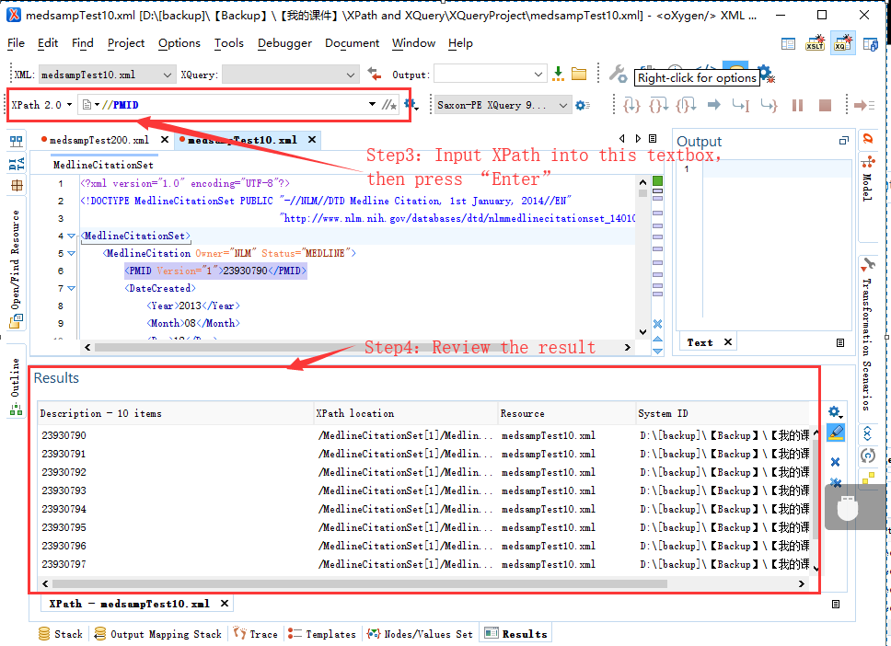
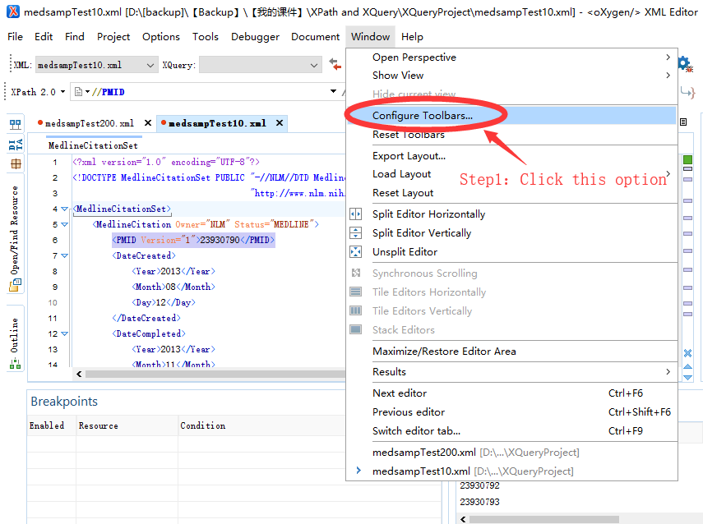
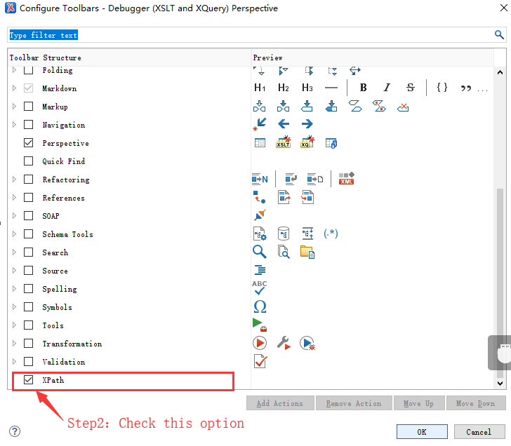
Set up XPath test Environment
https://codebeautify.org/Xpath-Tester

Slide 13
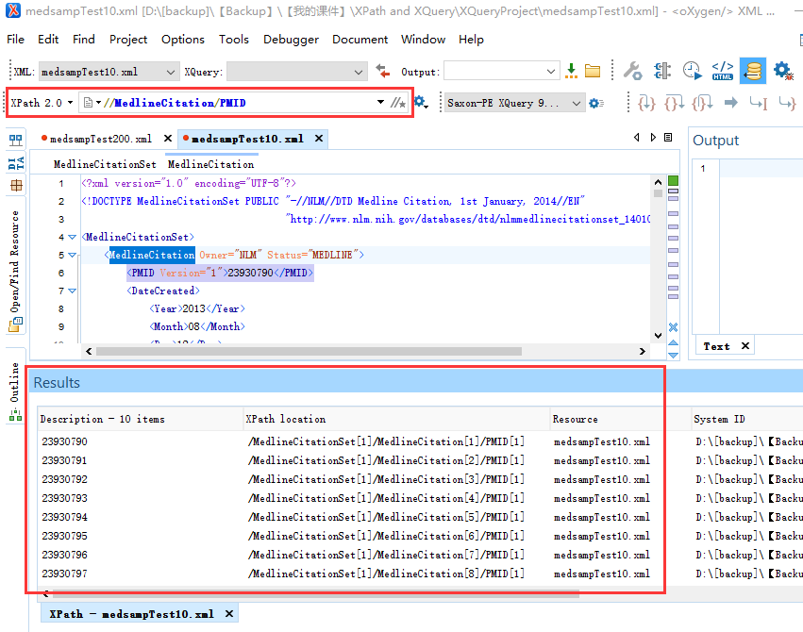
Result of Query (1)

Slide 14
Path Expressions in XPath (2)
Address all Author elements
//Author
Here // says that we should consider all elements in the document and check whether they are of type author
This path expression addresses all author elements anywhere in the document

Slide 15
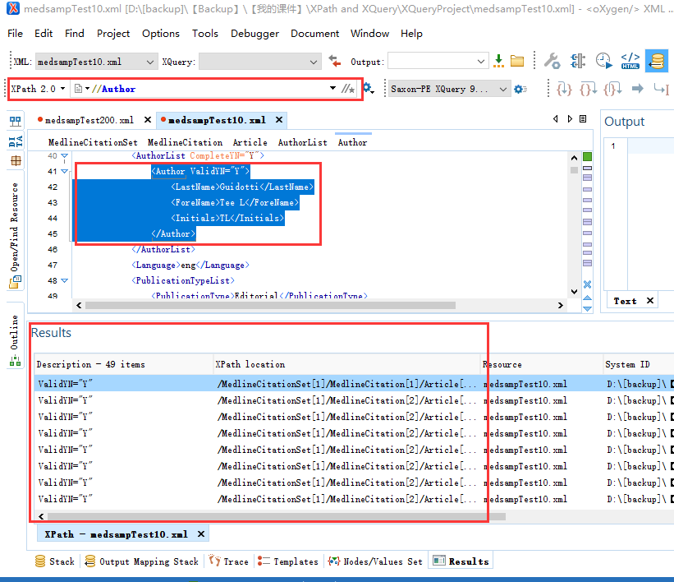
Result for Query (2)

Slide 16
Path Expressions in XPath (3)
Address the location attribute nodes within library element nodes
/MedlineCitationSet/MedlineCitation/@Owner
The symbol @ is used to denote attribute nodes

Slide 17
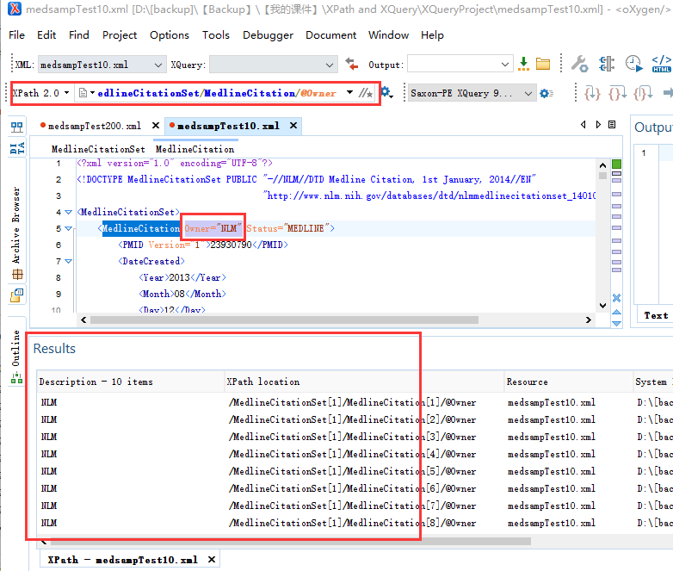
Result of Query 3

Slide 18
Path Expressions in XPath (4)
Select all Version attribute nodes within PMID elements anywhere in the document, which have the value “1”
//PMID/@Version="1"

Slide 19
Path Expressions in XPath (5)
Select all PMIDs with Version “1”
//PMID[@Version="1"]
Test within square brackets: a filter expression
It restricts the set of addressed nodes.
Difference with query 4.
Query 5 filters all PMID elements, the Version of which satisfies a certain condition.
Query 4 checks for certain Version attribute nodes of PMID elements

Slide 20
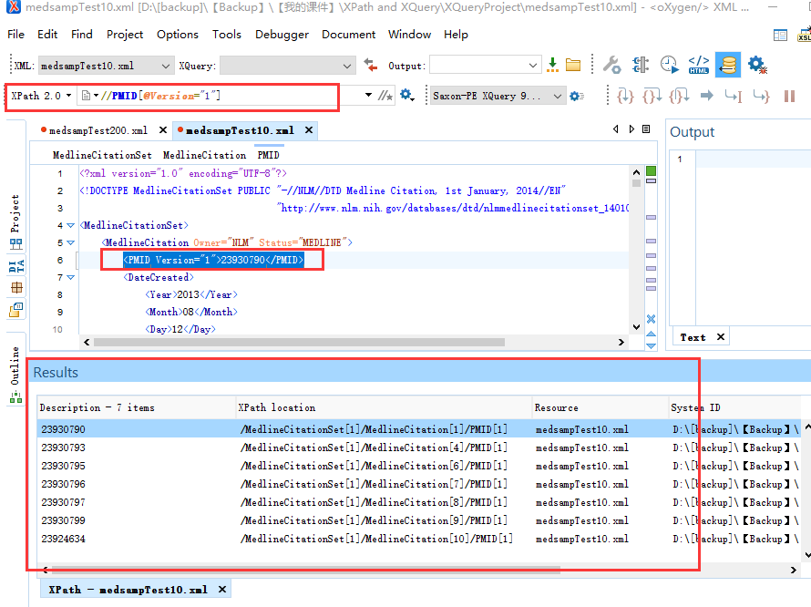
Result of Query (4)

Slide 21
Path Expressions in XPath (5)
Address the Second author element node in the Seond PubMed record
//MedlineCitation[2]/Article/AuthorList/Author[2]
Address the last Author element within the second PubMed record in the document
//MedlineCitation[2]/Article/AuthorList/Author[last()]
Select all PMID element nodes whose Version is not “1”
//PMID[@Version!=”1”]

Slide 22
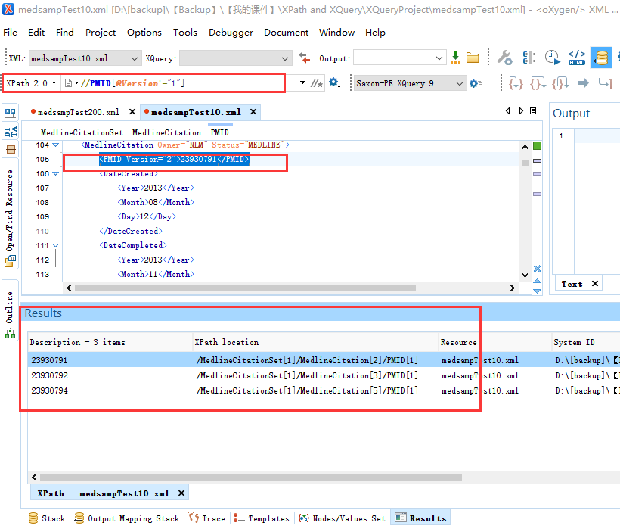
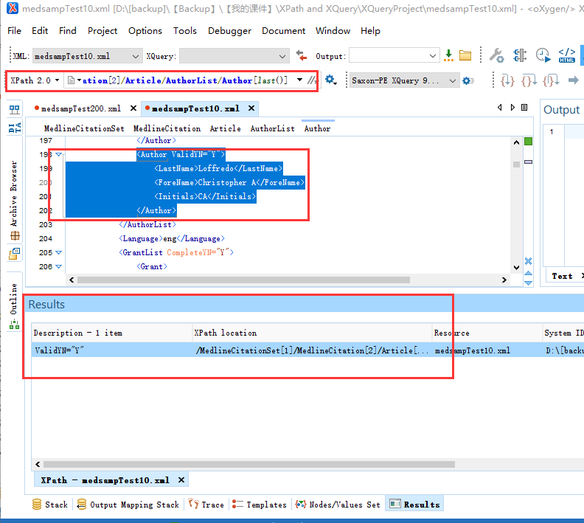
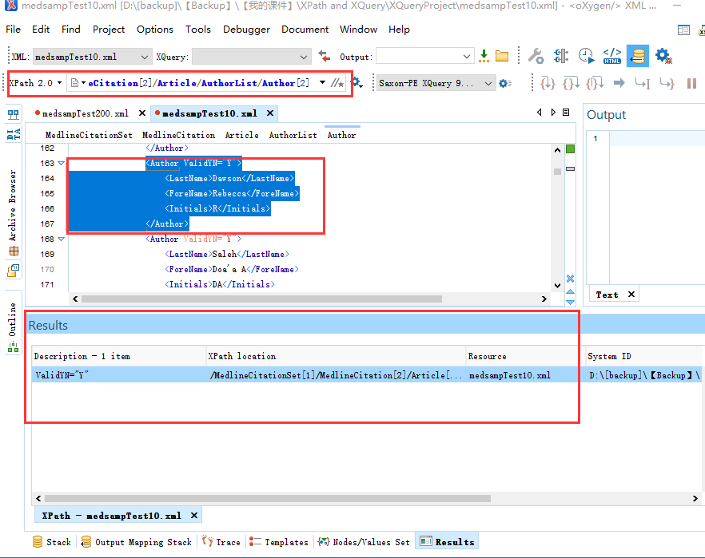
Results of Query set (6)

Slide 23
Path Expressions in XPath (7)
Count the number of PMID
count(//PMID)
List the authors with last name “Guidotti”
//Author[LastName="Guidotti"]
Count the number of authors with last name “Guidotti”
count(//Author[LastName="Guidotti"])

Slide 24
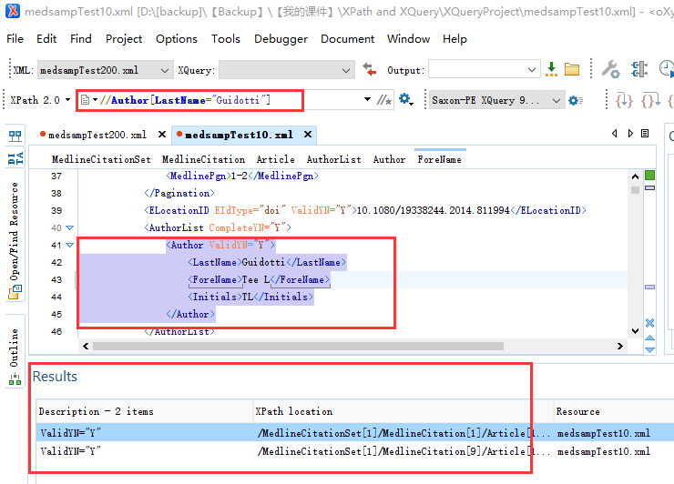
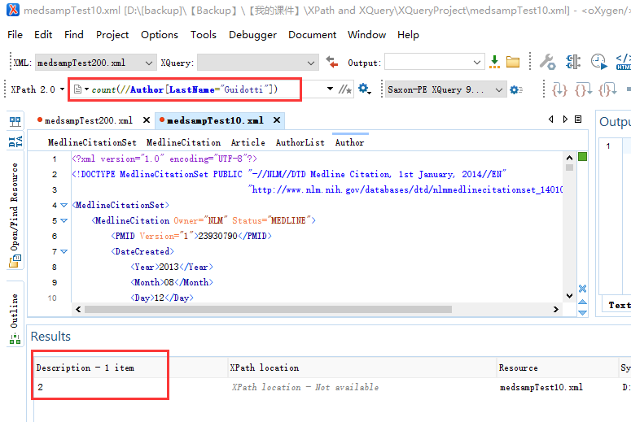
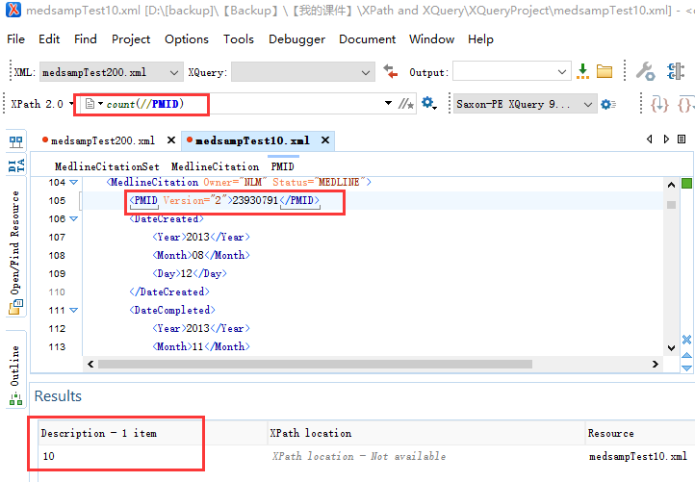
Results of Query set (7)

Slide 25
What is XQuery?
A query language that allows you to:
select elements/attributes from input documents
join data from multiple input documents
make modifications to the data
calculate new data
add new elements/attributes to the results
sort your results
Slides adapted from presentation by Priscilla Walmsley
http://www.datypic.com/services/xquery/intro.html

Slide 26
Example

Slide 27
Uses of XQuery
As varied as the uses for XML. Examples:
Extracting information from a database for use in a Web service
Generating summary reports on data stored in an XML database
Searching textual documents on the Web for relevant information and compiling the results
Selecting and transforming XML data to XHTML to be published on the Web
Pulling data from databases to be used for application integration
Splitting up an XML document that represents multiple transactions into multiple XML documents

Slide 28

XQuery Processing

Slide 29
XML Input
Could be:
text files that are XML documents
fragments of XML documents that are retrieved from the web using a URI
a collection of XML documents that are associated with a particular URI
data stored in native XML databases
data stored in relational databases that have an XML front-end
in-memory XML documents

Slide 30
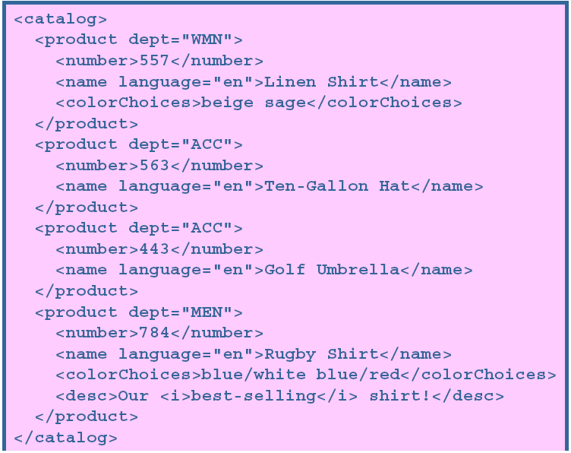
Example: Catalogue.xml

Slide 31
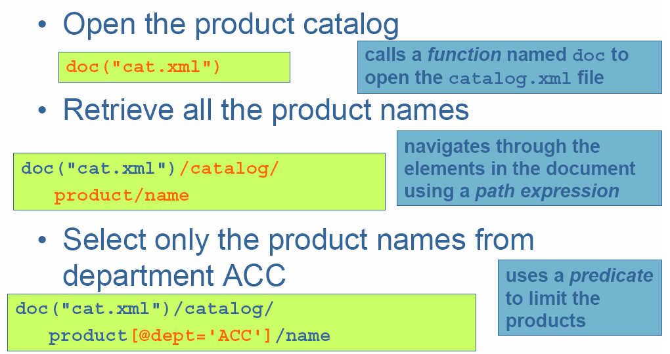
Selecting nodes

Slide 32
Results

Slide 33
Path Expressions and FLWOR
FLWOR expressions are analogous to SQL Select statement
FLWOR is an acronym for "For, Let, Where, Order by, Return".

Slide 34
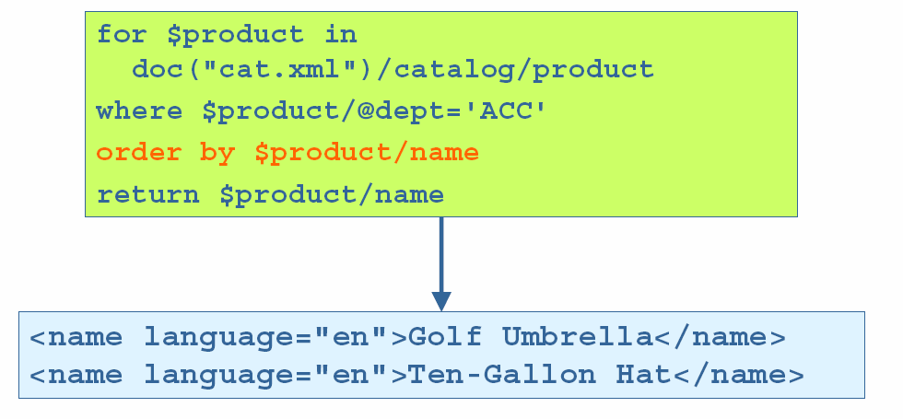
Sort results

Slide 35
Wrap results in a <ul> element

Slide 36
Wrap each name in a <li> element

Slide 37
Eliminate the name

Slide 38
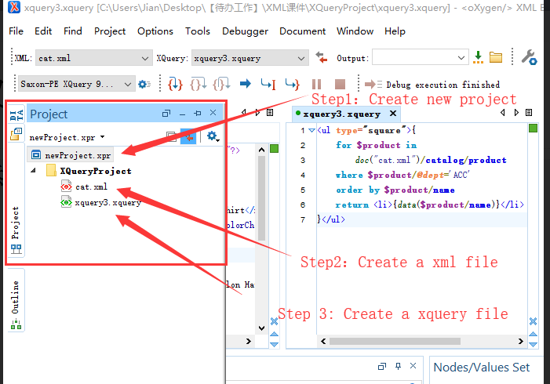
Run in Oxygen XML Editor (1)

Slide 39
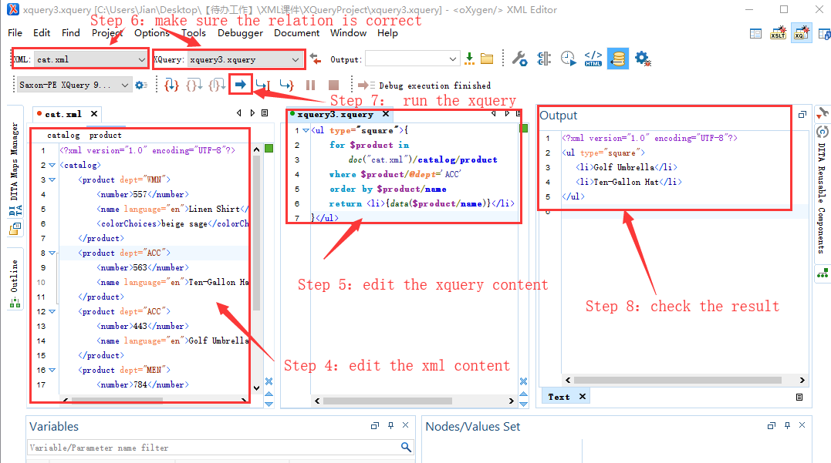
Run in Oxygen XML Editor (2)

Slide 40
Tools
XPath Evaluator (free online):
https://codebeautify.org/Xpath-Tester
XQuery
Oxygen: http://www.oxygenxml.com/
XMLSpy (trial): http://www.altova.com

Slide 41
Illustration
XQuery
XML
Validating parser
XQuery engine
DTD/ schema
XML
Browser
XSL
XML/ text/ HTML
Assist
XPath

Slide 42
Possible Application
Web/ Gnutella gateway
XML index file
XML
XML index file
Web
XQuery
XML index file
XML index file
XQuery
Other P2P client
Other presentation method
XML index file
P2P

Slide 43
Suggested Reading
Semantic Web Primer, Chapter 2
XML Path Language, J.Clark, http://www.w3.org/TR/xpath
XPath tutorial: http://www.w3schools.com/xpath/default.asp
XQuery tutorial: http://www.w3schools.com/xquery/default.asp
Detailed XQuery tutorial: http://www.datypic.com/services/xquery/IntroductionToXQuery.pdf

